Slide 1
CPUs and CRA support
V1.7
Apollo Lake update
July 17 2026

Slide 2
Big update
Intel provides standard 5 year of security updates support free of charge
after a product goes EOL (page 7)
Intel announced a couple of products have seen their life being extended by a couple of years (page 8)
The network products security status support for Ice Lake D, has not been defined yet by Intel. Others like Broadwell DE and Denverton are supposed to EOL before December 2027 anyway (page 6)
For AMD we are still inquiring

Slide 3
CRA support
Core Ultra (U, H, S, PS)
SBOM and CVE publishing mandatory
Full CRA compliance mandatory

Slide 4
CRA support
Core (U, H, S, PS)
SBOM and CVE publishing mandatory
Full CRA compliance mandatory

Slide 5
CRA support
Atom / Entry level type
SBOM and CVE publishing mandatory
Full CRA compliance mandatory
EOS
EOS announcement to keep selling until 12/2027
FREE Baseline Security Updates support (CRA)
FREE Baseline Security Updates support (CRA)
FREE Baseline Security Updates support (CRA)
FREE Baseline Security Updates support (CRA)
FREE Baseline Security Updates support (CRA)
CRA Support is unknown toady !!!!!!!!!!!!!!!!
EOS
ST
O
P
EOS
ST
O
P
ST
O
P
Last day to sell in EMEA
no CRA support

Slide 6
CRA support
Headless
SBOM and CVE publishing mandatory
Full CRA compliance mandatory
Unkown
Unkown
Unkown
No CRA related support
ST
O
P
No CRA related support
ST
O
P
No CRA related support
ST
O
P
ST
O
P
TBD

Slide 7
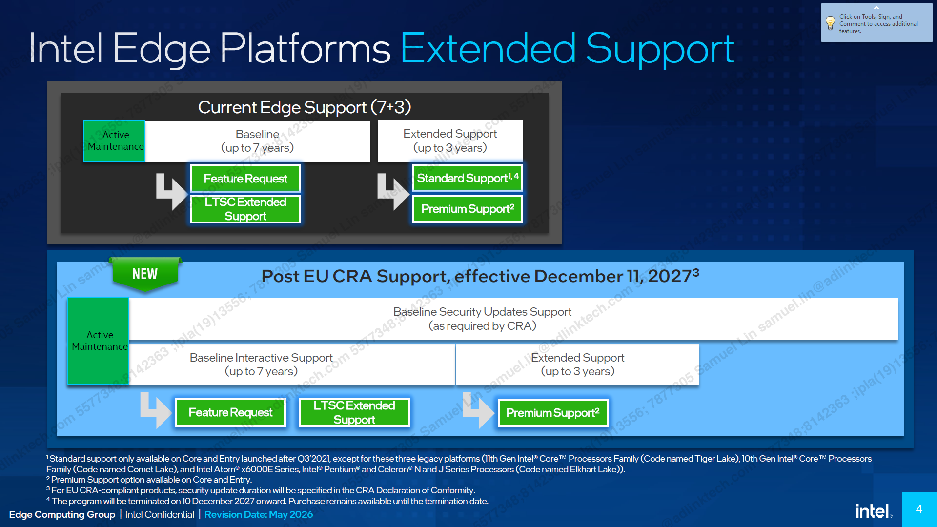

Slide 8
