Slide 1

ADLINK 2026 H2 Promotion Campaigns by Verticals/Applicationscl3
 | July | Aug | Sep | Oct | Nov | Dec
Vertical #1 | Robotics |  | Media Player | Medical Edge AI
Marketing Materials | eDM, ebook Linkedin ABM, post |  | EDM, Linkedin post | Landing page, eDM, social meda posts
Vertical #2 | Railway | Railway | Railway
Marketing Materials | Onboard edge gateway whitepaper, linkedin organic, eDM | Passenger information display video, linkedin organic, InnoTrans eDM | Railway edge ai computer video, linkedin organic, InnoTrans eDM
Vertical #3 |  | Manufacturing (PCIe Motion/Vision/IO card)
Marketing Materials |  | Landing page, Edm Linkedin Posts

Slide 2
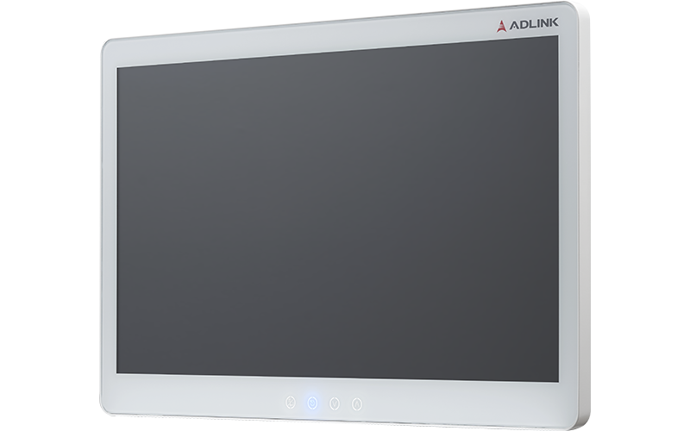
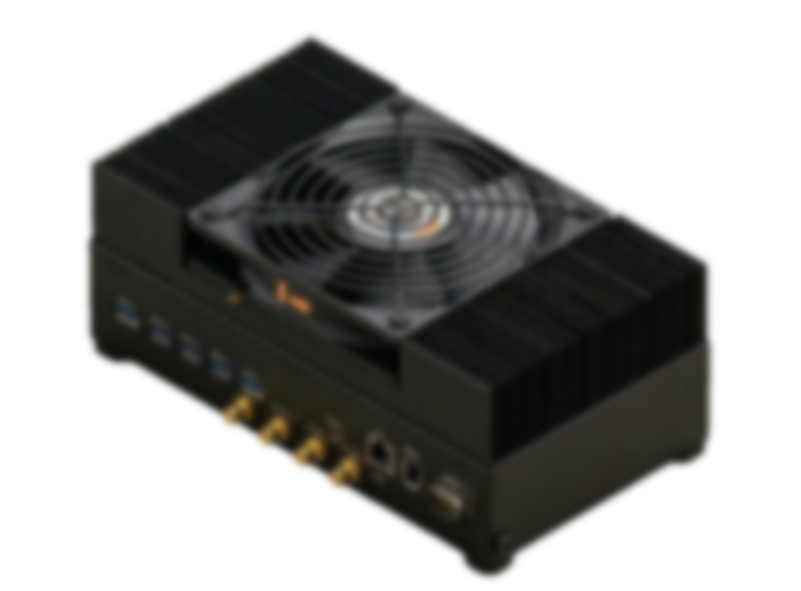
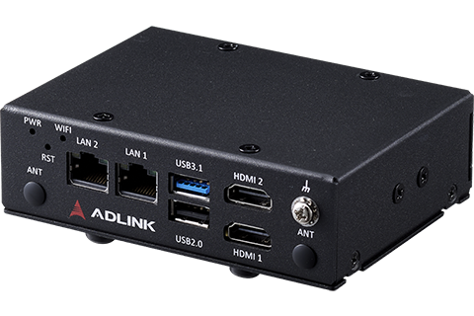
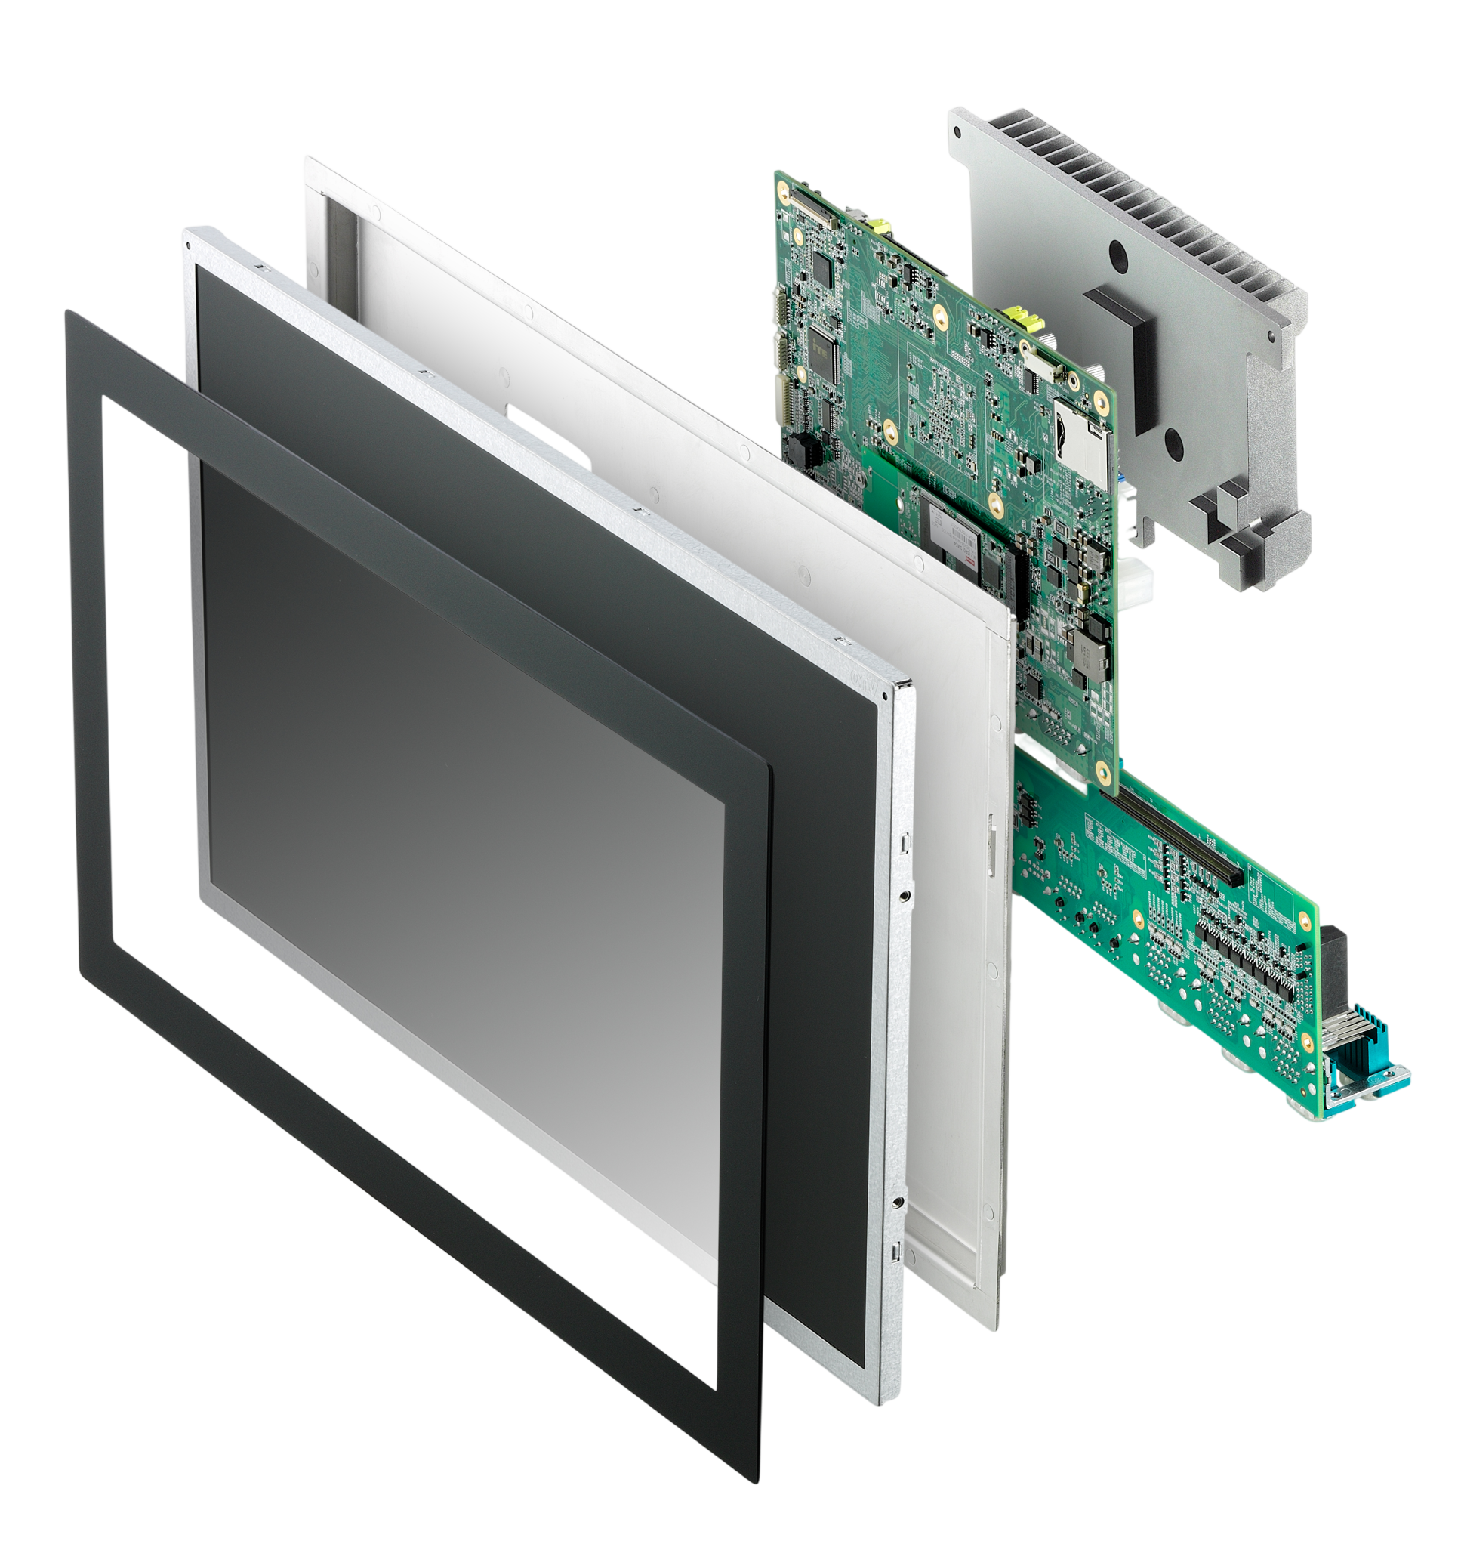
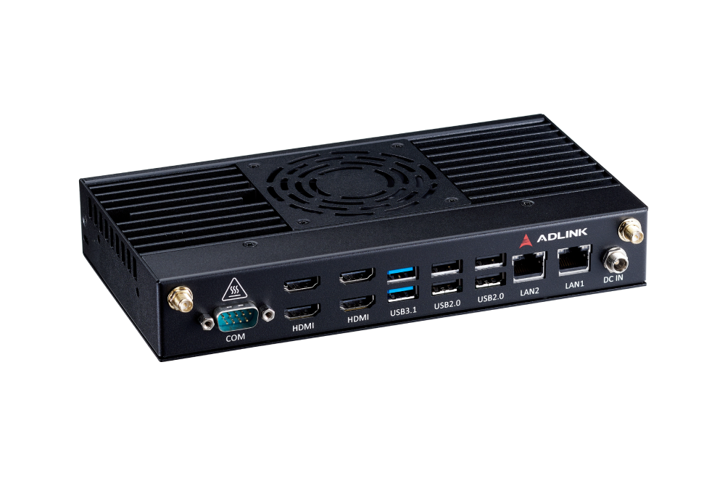
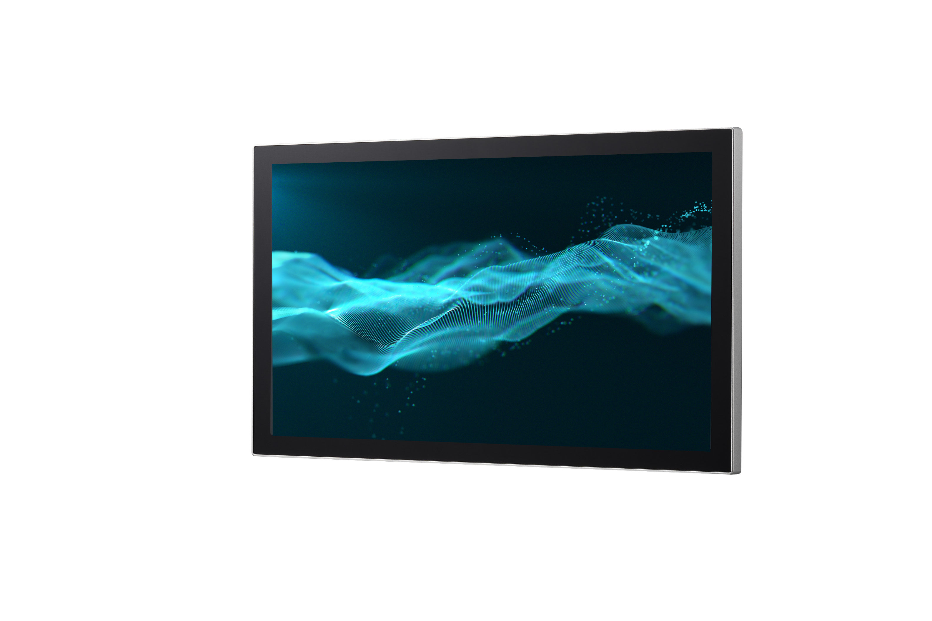
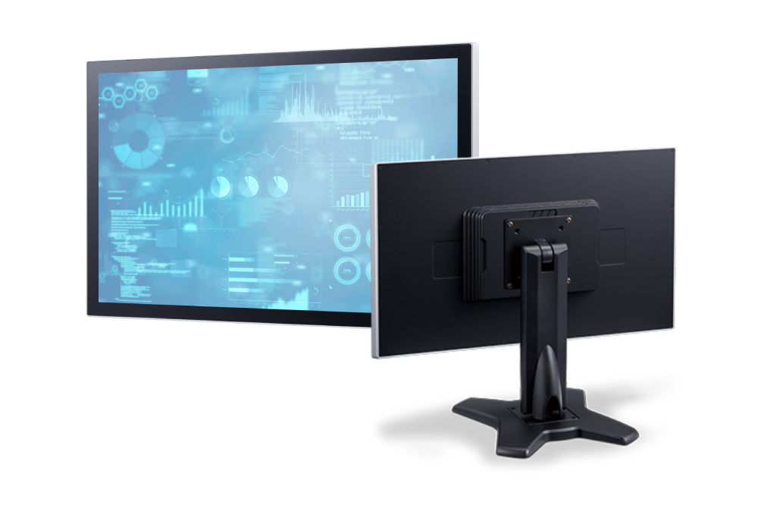
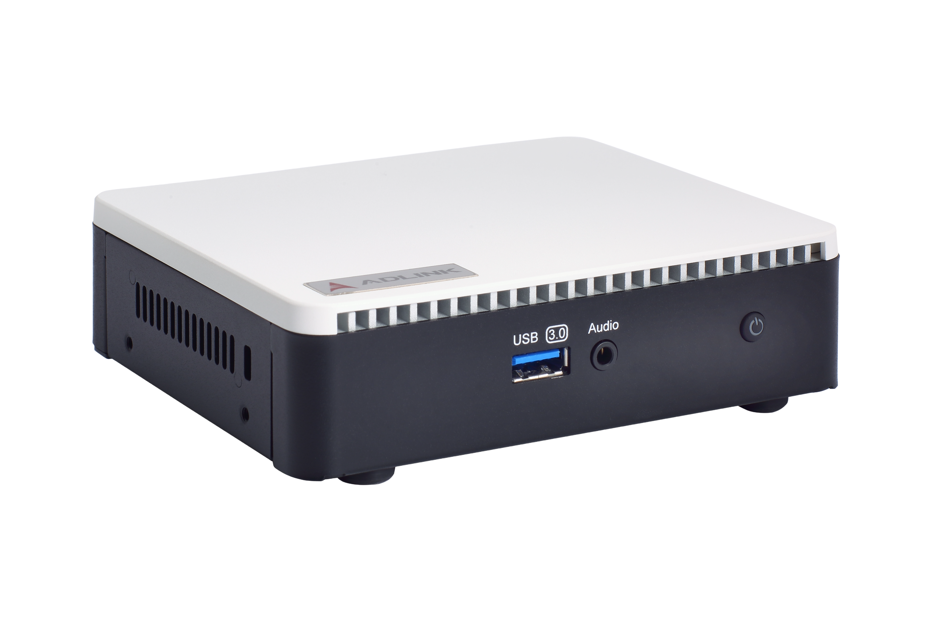
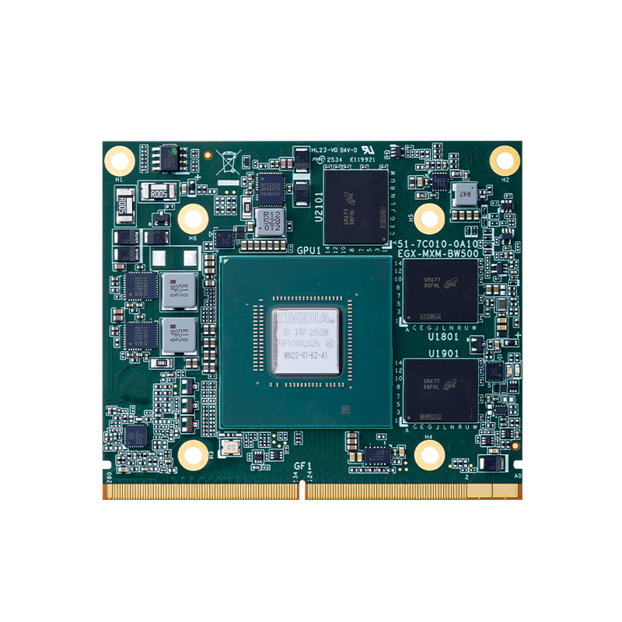
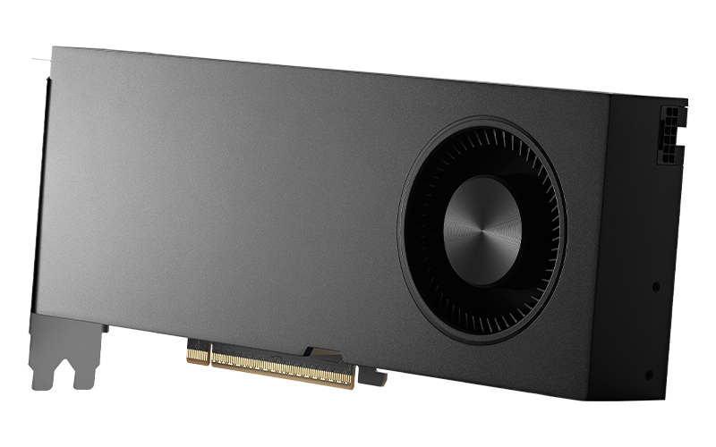
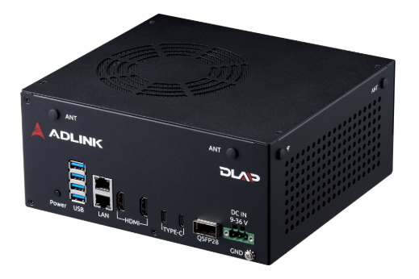
ADLINK 2026 H2 Promotion Campaigns by Platforms/Products
 | July | Aug | Sep | Oct | Nov | Dec
Product #1 | Arm-based dual display solutions MXA-312 | DICOM Clinical Monitor ACM Series |  |  |  | Nvidia Jetson Thor with GMSL2 DLAP-71G
Marketing Materials | Application stories, eDM, short videos | Sales kit, social media posts, eDM |  |  |  | Use case, linkedin post
Product #2 | SP2-TWL Open Frame Panel PC | EMP Series Digital Signage/ Media Player | IM/OM Standalone/ Embedded Monitors |  | STC2-TWL All-in-One Panel PC
Marketing Materials | Sales Kit LinkedIn Posts | Sales Kit Short Video | Sales Kit |  | Sales Kit
Product #3 | Blackwell GPU & Platform | DLAP Thor family profuct
Marketing Materials | eDM, social media posts | Banner, LinkedIn Posts

