Slide 1

ASD+
Industrial & Enterprise-Grade
SSD Storage by ADLINK
Edge Computing Platform BU
Product Manager: Alex YM Lin
Product Marketer: Enid Chiu

Slide 2

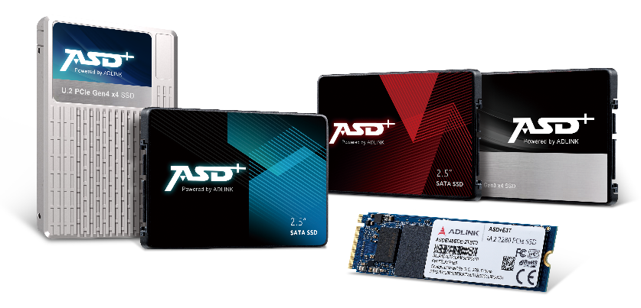






ADLINK ASD+
Industrial & Enterprise-Grade SSD Storage
Data Security/ Flash Optimization/
Power Loss Protection/ Customization Service
5 year
Warranty
3 year
Warranty
Enterprise Series
Industrial Series
Ultra-low latency with a maximum read-and-write speed of up to 7000 MB/s.
Wide capacities range from 480 GB to an expansive 30.72 TB.
Robust security with FIPS, TCG-OPAL compliance, secure erase features, and write protection.
Balances TLC NAND's high capacity with p-SLC's durability and speed, offering superior performance and longevity.
Reliable in -40°C to 85°C thermal range for diverse environments.
Power Loss Protection (PLP) ensures uninterrupted operation 24/7.

Slide 3








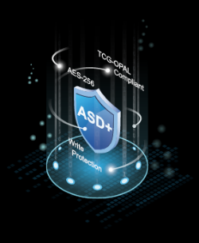




ADLINK ASD+ SSDs
Optimized for Data-Heavy and Rugged Environments
ADLINK's embedded flash storage solutions include industrial and enterprise grades, designed for tough environments. They offer key flash technology benefits like high transfer speeds, lightweight design, and low power usage. Industrial-grade models ensure reliability in harsh conditions, and enterprise-grade versions deliver high performance and data integrity for data-heavy applications. This diverse portfolio boosts efficiency and reliability across numerous applications.
Reliable & Secure
Customization
Longevity
Resilience
U.2 PCIe
M.2 PCIe
M.2 SATA
2.5” SATA
Data Security
TCG-OPAL compliant
Secure Erase and Crypto Erase
Read-and-Write Protection
Flash Optimization
Garbage Collection and TRIM
Advanced Wear Leveling to increase life cycle
Bad Block Management
Over Provision for enhanced performance
Power Loss Protection
Comprehensive protection ensures data integrity
Built-in voltage stabilizer for internal power supply
Reliable startup power sequence
Customization Service
Time to market design-in service
Early access to the latest Flash technology
With a 3-5 year warranty
Device Management Software
Graphical web platform for monitoring device status and performance, including SSDs.
Advanced security with onboarding, encryption, SSO (LDAP), and access controls.
3

Slide 4


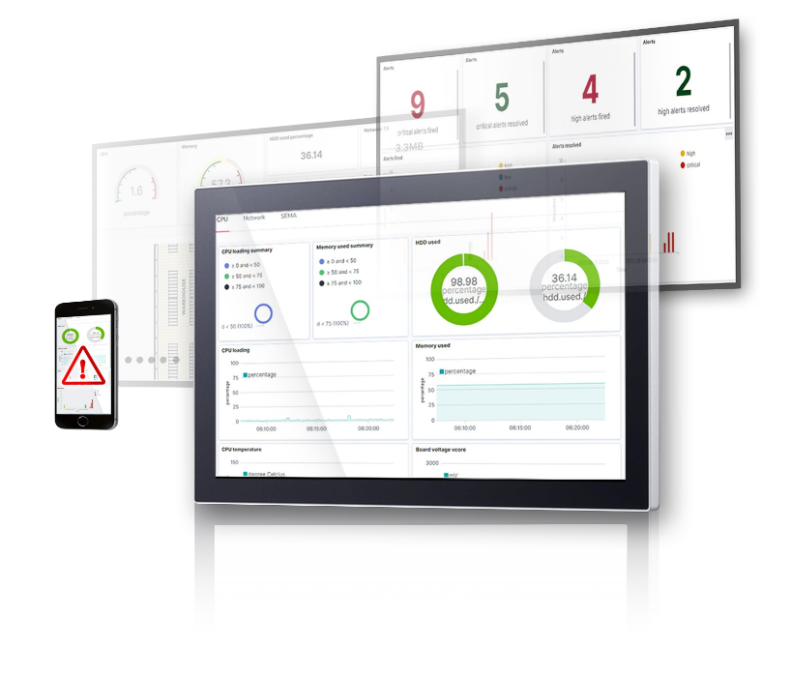






Remote Device Management Software for All Edge Devices
Device Management
Secure device onboarding
Remote desktop and web terminal
Customized Dashboard
Remote script execution
Customizable interface, statistics, and charts
Real-time Notifications
Can upload custom data to the integrated database
Event monitoring with customizable trigger values
Edge Security
Alerts by Choice of Platform (Email, LINE, Teams, etc.)
Secure connections between server and agents
User-set thresholds for CPU, memory, storage usage warnings, and more.
Flexible role-based access control in one portal
USB port block prevents malware spreading
Package Deployment
Run packages on remote devices
Exclusive ADLINK Features
Reuse and manage packages in the server repository
Smart Embedded Management Agent (SEMA) integration
ASD+ SSDs lifetime estimation
4
Notes:
Upload customize data to integrated database

Slide 5

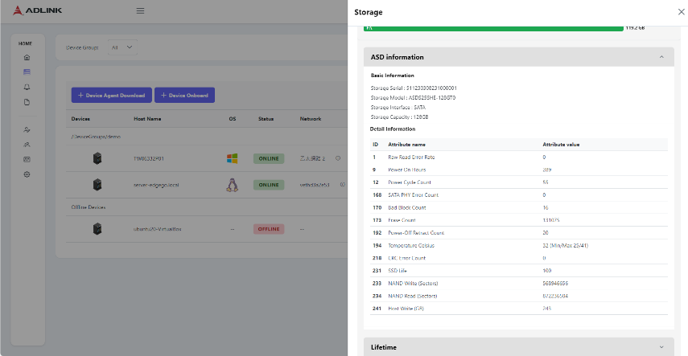
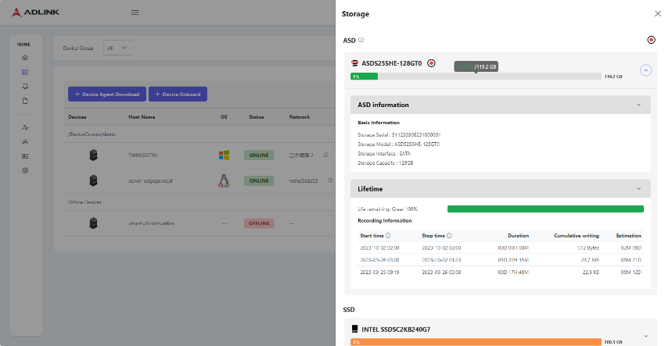
The Edge-Native Platform for ASD+ SSD Monitoring
SSD Info Overview
A clear view of SSD details
Hassle-free supervision with dynamic visual dashboard
Only available for ADLINK ASD+ SSDs
Lifetime Monitoring
Summary logs of recording hours and capacities
Lifetime estimation to determine optimal SSD models and replacement based on user work cycles
Only available for ADLINK ASD+ SSDs
5

Slide 6
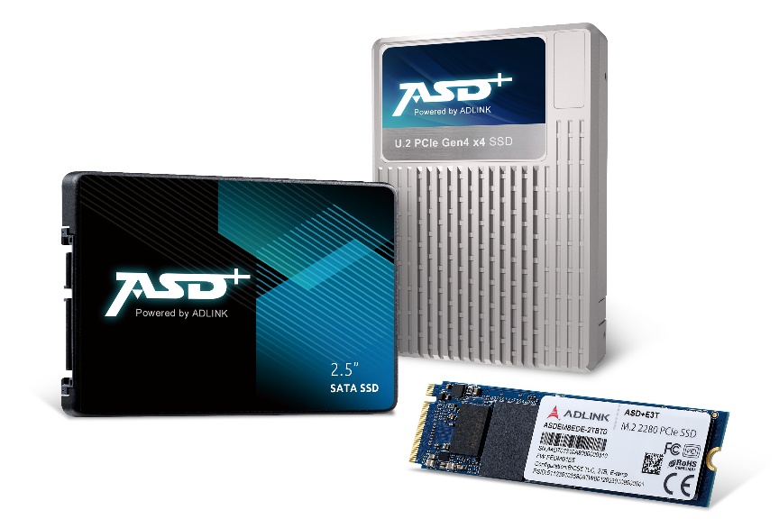



Enterprise Series
Engineered to Meet All High-Volume Data Storage Demands
ADLINK's ASD+ Enterprise Series SSDs are tailored for high-performance and data-heavy enterprise applications. The series includes the SDC12 in a 2.5" form factor, the EDC18 as an M.2 module, and the EDCP1 as a U.2 SSD, all with PCIe Gen4 connectivity and 3D-TLC flash for superior speed and efficiency. Capacities range from 480 GB to an expansive 30.72 TB. With DDR4 cache memory and impressive endurance, these SSDs assure continuous operation in tough environments, backed by a five-year warranty for long-term reliability.
High-capacity
Secure
Ultra-low Latency
6

Slide 7



ASD+ Enterprise Series
ADLINK's ASD+ Enterprise SSDs offer superior performance and up to 30.72 TB capacity, featuring PCIe Gen4 and 3D-TLC flash. These durable SSDs, including the SDC12, EDC18, and EDCP1, ensure robust, high-capacity operations backed by a five-year warranty.
0°C
70°C
Superior Performance
PCIe
(NVMe)
EDC18
(M.2)
EDCP1
(U.2)
SATA
SDC12
(2.5”)
Provides customization of CF, PATA SSD, SD, Micro SD, eMMC, BGA SSD (with MOQ)

Slide 8





Designed For Heavy Data Logging
Data Centers
High Classify Military Facility
Financial Service
AI Server
Automotive Data Logger
Autonomous Vehicle / AMR / UAV / UCAV
Aviation /Railway
Sensor Fusion Data Analysis
Artificial Intelligence (AI)
Generative AI (i.e. Digital Twin, NIVIDIA Omniverse)
MachineLearning/DeepLearning
Big Data Analysis
32 TB
High Capacity
High Speed
7000 MB/s
8
Notes:
Intensive Data Demand

Slide 9
Enterprise-Grade ASD+ vs Industrial-Grade ASD+
Industrial SSDs are built for harsh environments and demanding industrial applications, focusing on durability and longevity. Enterprise SSDs, on the other hand, are optimized for high-performance data center and server applications, emphasizing reliability and scalability. The choice between the two depends on your specific application requirements and environments.
 | Enterprise SSD | Industrial SSD
Capacity | Up to 32TB | Up to 16TB
Latency | Ultra-low | Low
Operation Temperature Range | 0 - 70°C | -40 - 85°C
4K Random R/W | Up to 1,600K/480K IOPS (U.2 PCIe) | Up to 600K/200K IOPS (U.2 PCIe)
Sequential R/W | Up to 7000/6800 MB/s (U.2 PCIe) | Up to 3300/1000 MB/s (U.2 PCIe)
Power Consumption | Max. 3,800 mW | Max. 1,750 mW
Warranty | 5 years | 3 years
Dual Port | Yes | No
9

Slide 10
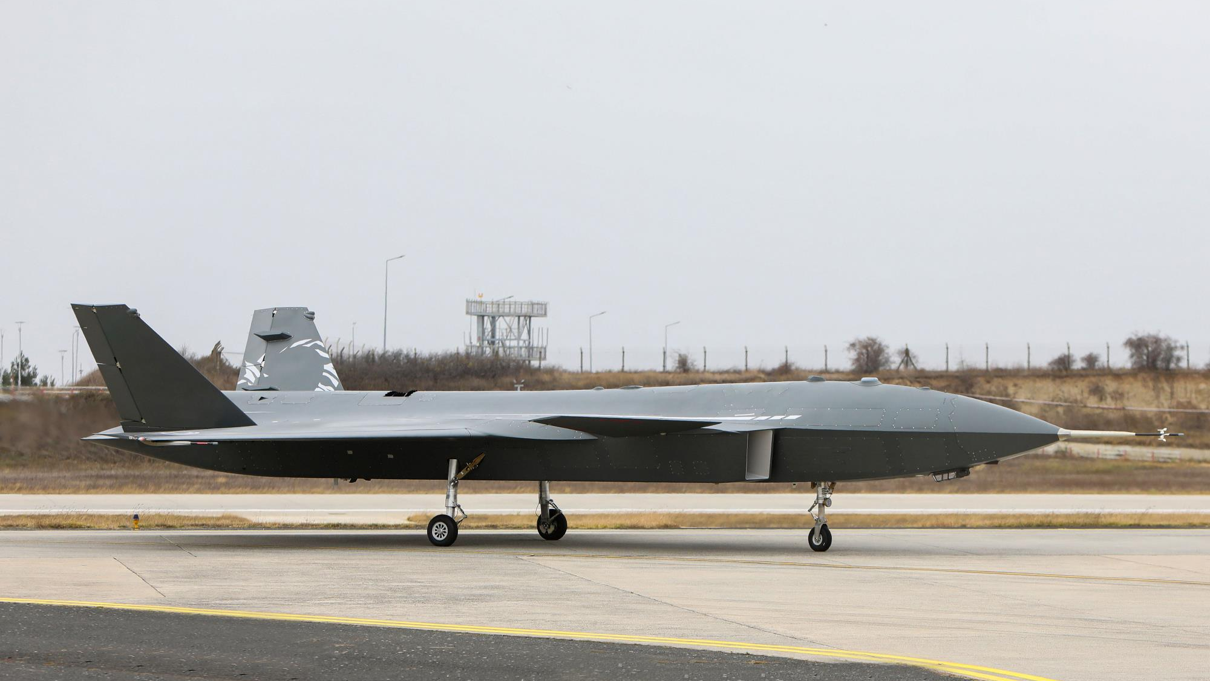
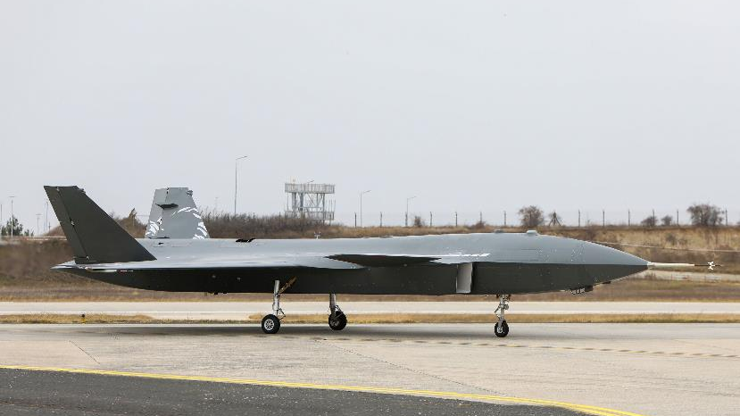

ASD+ Enterprise Series SSDs
Unmanned Combat Aerial Vehicle (UCAV)
Secure Data Protection For Sensitive Information
Unmanned Combat Aerial Vehicles (UCAVs), commonly known as combat drones, are sophisticated military aircraft that are designed for various combat and surveillance missions. These UCAVs often incorporate advanced technologies, including data storage solutions like enterprise SSDs. The use of enterprise SSDs in UCAVs is primarily driven by the need for reliable, high-performance, and rugged storage solutions.
Why using Enterprise Series SSDs in UCAVs?
Reliability : Enterprise SSDs are known for their high reliability. In military applications like UCAVs, where operational failure can have severe consequences, having reliable data storage is essential. Enterprise SSDs are designed to withstand challenging conditions and are less prone to data loss or corruption.
Endurance: UCAVs engage in surveillance and combat missions that involve constant data recording and transmission. Enterprise SSDs typically offer high endurance, making them suitable for extensive write operations without wearing out quickly.
Performance: UCAVs require fast data access and storage capabilities to ensure real-time processing and decision-making during missions. Enterprise SSDs offer high read and write speeds, low latency, and consistent performance, which are crucial in these scenarios.
Data Security: Military missions involve sensitive and classified data. Enterprise SSDs often come with built-in data security features, such as hardware encryption and secure erase functions, to protect against unauthorized access and data breaches.
Regulatory Compliance: Military applications often have strict regulatory and compliance requirements. Enterprise SSDs are designed with these considerations in mind and may adhere to military standards and certifications.
Recommended Product: EDC18 (M.2 PCIe)
10

Slide 11


ASD+ Enterprise Series SSDs
Automotive Data Logger (Autonomous)
Highly Intensive Data Logging Environment
An automotive data logger is a hardware and software system that collects and records a wide range of data points from sensors, cameras, LiDAR, radar, GPS, and other onboard components in an autonomous vehicle. These data points may include information about the vehicle's surroundings, its own state, the actions it takes, and the behavior of other road users. Autonomous vehicles generate vast amounts of data that need to be stored, managed, and accessed reliably and efficiently accessed reliably and efficiently.
Why using Enterprise SSDs for Automotive Data Logger?
Reliability : Enterprise SSDs are designed for heavy workloads and are typically more durable and reliable than industrial-grade SSDs. Given the critical nature of data logging in an autonomous vehicle, the reliability of storage is paramount. Enterprise SSDs are built to handle continuous read/write operations and are equipped with features like power loss protection to prevent data corruption.
Endurance: Autonomous vehicles generate a massive amount of data, and data loggers frequently write to the storage device. Enterprise SSDs often have higher endurance ratings than industrial SSDs, which means they can withstand more write cycles. Look for SSDs with high program-erase (P/E) cycles to ensure they can handle the constant data writing.
Performance: Autonomous vehicle data loggers require high read and write performance to record and retrieve data in real-time. Enterprise SSDs often offer consistent and predictable performance, making them suitable for this purpose. Pay attention to factors like read/write speeds and IOPS.
Warranty and Support: Enterprise SSDs often come with longer warranties and better support options compared to industrial SSDs. This can be crucial for maintaining the reliability of data logger systems.
Recommended Product: EDC18 (M.2 PCIe)

Slide 12



ASD+ Enterprise Series Selection Guide
 | SDC12 | EDC18 | EDCP1
Form Factor | 2.5” SSD | M.2 2280/2242 M Key | U.2 SSD
Interface | SATA Gen 3 | PCIe Gen4 x4 NVMe 1.4 | PCIe Gen4 x4 NVMe 1.4
Flash Type | 3D-TLC | 3D-TLC | 3D-TLC
Capacity | 480, 960, 1920 GB | 480, 960, 1920 GB | 1920, 3840, 7680, 15360, 30720 GB | 800, 1600, 3200, 6400, 12800, 25600 GB | 800, 1600, 3200, 6400, 12800, 25600 GB
Cache Memory | DDR4 | DDR4 | DDR4
4K Random R/W | Up to 98K/50K IOPS | Up to 800K/58K IOPS | Up to 1,600K/480K IOPS
Sequential R/W | Up to 530/550 MB/s | Up to 5500/2000 MB/s | Up to 7000/6800 MB/s
Reliability (MTBF) | More than 1.5M hrs | More than 2M hrs | More than 2.5M hrs
Reliability (DWPD) | 1 | 1 | 1 |  | 3
Temperature | C-grade: 0°C ~ 70°C | C-grade: 0°C ~ 70°C | C-grade: 0°C ~ 70°C
Warranty | 5 Years | 5 Years | 5 Years
12

Slide 13
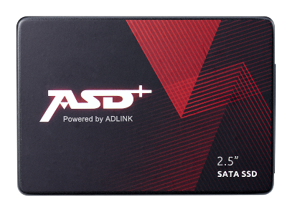
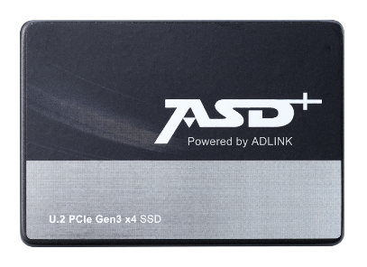
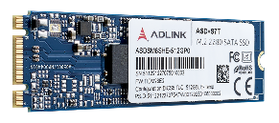


Industrial Series
Fulfills Every Industrial Applications
ADLINK’s ASD+ industrial SSDs offer a versatile range of storage solutions, with capacities from 128GB to 8TB. Available in both 2.5" and M.2 form factors, and with SATA and PCIe interfaces, these SSDs meet diverse operational demands. They feature temperature ranges of standard (0°C to 70°C), extended (-25°C to 85°C), and industrial-grade (-40°C to 85°C) to endure challenging conditions. Equipped with TLC and p-SLC technologies, they are suitable for read- and write-intensive operations. High transfer speeds, low power consumption, and sturdy construction make these SSDs a reliable choice for all industrial applications.
High Endurance
Uninterrupted
Wide Temperature Range
13

Slide 14


ASD+ Industrial Series
ASD+ Industrial Series provides many SSD options from write-intensive for enterprise to read-intensive for HMI and client applications, with different temperature ranges and form factors, fulfilling demands for a variety of applications.
0 - 70°C
-20 - 85°C
-40 - 85°C
Regular Performance
Premium Performance
PCIe
(NVMe)
E3T
(M.2)
E2D
(U.2)
SATA
S7T
(2.5” & M.2)
S2D
(2.5”)
Provides customization of CF, PATA SSD, SD, Micro SD, eMMC, BGA SSD (with MOQ)

Slide 15


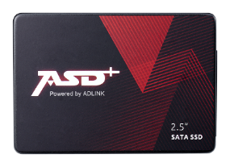
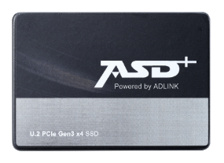

Designed for Reliable Operation
Military/ Surveillance (AI)
Write Intensive > 50%
High Performance & Endurance
Low Latency
Gaming/ Medical
Read Intensive > 80%
Read Random IOPS
Low Latency
Signage/ Retail
Read Intensive > 95%
Read Random IOPS
High Capacity
p-SLC
Write Intensive
Read Intensive
TLC
15

Slide 16



ASD+ Industrial Series SSD
Casino Gaming Machines
Reliable Slot and Electronic Gaming Machine Performance for Non-Stop Casino Action
In the casino sector, industrial-grade SSDs are crucial for the uninterrupted operation of slot machines and electronic gaming machines (EGMs). These SSDs provide essential high-speed data access and robust performance, capable of sustaining 24/7 gaming activities amidst the bustling environment of casinos. Their resistance to temperature changes and physical impacts ensures consistent machine reliability, preventing downtime and preserving player confidence and seamless casino operations.
Why using Industrial Series SSDs in Casino Gaming Machines?
Temperature Resilience: The SSDs in the Industrial Series can operate in a wide temperature range from 0°C to 70°C for standard grades, -20°C to 85°C for extended grades, and -40°C to 85°C for industrial grades. This ensures reliable performance in the varied thermal environment of a casino floor.
Endurance for Intensive Use: With read- and write-intensive options, these SSDs can handle the constant data throughput demands of casino gaming machines, which operate non-stop and often execute numerous transactions and gaming processes simultaneously.
Efficient Power Consumption: The low power usage of these SSDs helps reduce the overall energy costs for casinos, which operate a large number of machines continuously, contributing to a better energy footprint.
High-Speed Data Access: With fast data transfer rates, these SSDs enable quick game loads, rapid bet processing, and immediate reward display, which is essential for maintaining the fast-paced excitement that casino gamers expect.
Recommended Product: S2D (2.5” SATA)
16

Slide 17
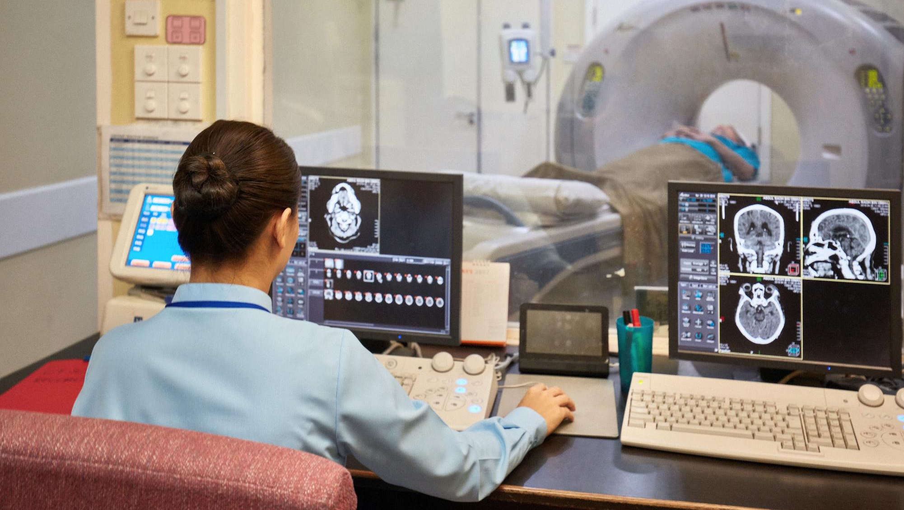

ASD+ Industrial Series SSD
CT and MRI Scanners
Reliability and Speed in Medical Imaging for Accurate and Swift Patient Care
In the medical field, industrial-grade SSDs are indispensable for advanced medical imaging equipment like CT and MRI scanners, which require rapid and reliable data handling. These SSDs offer the robustness and speed needed to process and store large volumes of diagnostic data efficiently, facilitating quick decision-making in emergency care while enduring the challenging conditions of medical environments.
Why using Industrial Series SSDs in Medical Imaging Equipment?
Optimal Performance in Varied Environments: Capable of operating in standard (0°C to 70°C), extended (-25°C to 85°C), and industrial-grade (-40°C to 85°C) temperatures, ensuring reliability in the diverse settings of medical facilities.
Tailored for Continuous Operation: Features read- and write-intensive capabilities with TLC and p-SLC technologies, handling the constant flow of large imaging data files without degradation.
Energy-Efficient Operation: Designed for low power consumption, which is crucial in medical environments where energy efficiency is as important as performance.
Scalable for High-Resolution Imaging: With storage capacity options ranging from 128GB to 8TB, these SSDs are well-suited for the vast amounts of data generated by medical imaging equipment.
Reliable in Demanding Conditions: The durable 2.5" and M.2 form factors are built to withstand the rigorous use found in medical applications, from portable imaging devices to stationary diagnostic machines.
Recommended Product: E3T (M.2 PCIe)
17

Slide 18
ASD+ Industrial Series Selection Guide
 | S7T |  | S2D | E3T | E2D | E1T
Form Factor | 2.5” SSD | M.2 2280/2242 B+M Key | 2.5” SSD | M.2 2280/2242 M Key | U.2 SSD | M.2 2280 M Key
Interface | SATA Gen3 | SATA Gen3 | SATA Gen3 | PCIe Gen3 x4 NVMe 1.3d | PCIe Gen3 x4 NVMe 1.3d | PCIe Gen4x4 NVMe 1.4
Flash Type | 3D-TLC/p-SLC | 3D-TLC/p-SLC | 3D-TLC/p-SLC | 3D-TLC/p-SLC | 3D-TLC | 3D-TLC
Capacity | 3D TLC: 128GB ~ 2 TB p-SLC: 32GB ~ 512GB | 3D TLC: 128GB ~ 2 TB p-SLC: 32GB ~ 512GB | 3D TLC: 2TB ~ 8TB p-SLC: 64GB ~ 2TB | 3D TLC: 128GB ~ 2TB pSLC: 32GB ~ 512GB | 480GB ~ 8TB | 256GB ~ 2TB
Cache Memory | DRAM-less | DRAM-less | DDR4 | DRAM-less | DDR4 | DRAM-less
4K Random R/W | 44,500/78,500 IOPS | 49,500/78,500 IOPS | 98,000/88,000 IOPS | 270,000/420,000 IOPS | 600,000/200,000 IOPS | 700K/900K IOPS
Sequential R/W | 550/530 MB/s | 550/510 MB/s | 520/510 MB/s | 2450/1900 MB/s | 3300/1000 MB/s | 4900/3700 MB/s
Reliability (MTBF) | More than 3M hrs | More than 2M hrs | More than 3M hrs | More than 2M hrs | More than 2M hrs | More than 1.5M hrs
Reliability (DWPD) | 3D TLC > 0.64 p-SLC > 44 | 3D TLC > 0.64 p-SLC > 28 | 3D TLC > 0.64 p-SLC > 44 | 3D TLC > 0.7 p-SLC > 28 | 3D TLC > 1.5 | 3D TLC > 0.85
Temperature | E-grade: -25°C - 85°C I-grade: -40°C - 85°C | E-grade: -25°C - 85°C I-grade: -40°C - 85°C | C-grade: 0°C - 70°C I-grade: -40°C - 85°C | E-grade: -25°C - 85°C I-grade: -40°C - 85°C | C-grade: 0°C - 70°C I-grade: -40°C - 85°C | C-grade: 0°C - 70°C I-grade: -40°C - 85°C
Warranty | 3 Years | 3 Years | 3 Years | 3 Years | 3 Years | 3 Years

Slide 19

Thank You!
19

Slide 20

Ordering Information
20

Slide 21

ASD+ Enterprise Series Overall Part Number
Model | Conf. | FF | Temp. | Capacity | PN
SDC12 | TLC | 2.5" | 0°C ~ 70°C | 480GB | ASDXS25SMC-480GTF
 |  |  |  | 960GB | ASDXS25SMC-960GTF
 |  |  |  | 1920GB | ASDXS25SMC-1920TF
 |  |  |  | 3840GB | ASDXS25SMC-3840TF
 |  |  |  | 7680GB | ASDXS25SMC-7680TF
Model | Conf. | FF | Temp. | Capacity | PN
EDC18 | TLC | PCIe Gen4x4 M.2 2280 | 0°C ~ 70°C | 480GB | ASDXEM8ECC-480GTF
 |  |  |  | 960GB | ASDXEM8ECC-960GTF
 |  |  |  | 2TB | ASDXEM8ECC-2TBTF
21

Slide 22
ASD+ Enterprise Series Overall Part Number
Model | Conf. | FF | Temp. | DWPD | Capacity | PN
EDCP1 | TLC | U.2 | 0°C ~ 70°C | 1 | 2TB | ASDXU25PMC-2TBTF
 |  |  |  |  | 4TB | ASDXU25PMC-4TBTF
 |  |  |  |  | 8TB | ASDXU25PMC-8TBTF
 |  |  |  |  | 16TB | ASDXU25PMC-16TBTF
 |  |  |  |  | 32TB | ASDXU25PMC-32TBTF
 |  |  |  | 3 | 800GB | ASDXU25PWC-800GBTF
 |  |  |  |  | 1.6TB | ASDXU25PWC-1600GBTF
 |  |  |  |  | 3.2TB | ASDXU25PWC-3200GBTF
 |  |  |  |  | 6.4TB | ASDXU25PWC-6400GBTF
 |  |  |  |  | 12TB | ASDXU25PWC-12TBTF
 |  |  |  |  | 24TB | ASDXU25PWC-25TBTF
22

Slide 23
ASD+ Industrial Series Overall Part Number
Model | Conf. | FF | Temperature | Capacity | PN | Conf. | FF | Temperature | Capacity | PN
S7T | TLC | 2.5” | -25°C ~ 85°C | 128GB | ASDS25SHE-128GT0 | pSLC | 2.5” | -25°C ~ 85°C | 32GB | ASDS25SHE-32GP0
 |  |  |  | 256GB | ASDS25SHE-256GT0 |  |  |  | 64GB | ASDS25SHE-64GP0
 |  |  |  | 512GB | ASDS25SHE-512GT0 |  |  |  | 128GB | ASDS25SHE-128GP0
 |  |  |  | 1TB | ASDS25SHE-1TBT0 |  |  |  | 256GB | ASDS25SHE-256GP0
 |  |  |  | 2TB | ASDS25SHE-2TBT0 |  |  |  | 512GB | ASDS25SHE-512GP0
 |  |  | -40°C ~ 85°C | 128GB | ASDS25SHI-128GT0 |  |  | -40°C ~ 85°C | 32GB | ASDS25SHI-32GP0
 |  |  |  | 256GB | ASDS25SHI-256GT0 |  |  |  | 64GB | ASDS25SHI-64GP0
 |  |  |  | 512GB | ASDS25SHI-512GT0 |  |  |  | 128GB | ASDS25SHI-128GP0
 |  |  |  | 1TB | ASDS25SHI-1TBT0 |  |  |  | 256GB | ASDS25SHI-256GP0
 |  |  |  | 2TB | ASDS25SHI-2TBT0 |  |  |  | 512GB | ASDS25SHI-512GP0
 |  | M.2 | -25°C ~ 85°C | 128GB | ASDSM8SHE-128GT0 |  | M.2 | -25°C ~ 85°C | 32GB | ASDSM8SHE-32GP0
 |  |  |  | 256GB | ASDSM8SHE-256GT0 |  |  |  | 64GB | ASDSM8SHE-64GP0
 |  |  |  | 512GB | ASDSM8SHE-512GT0 |  |  |  | 128GB | ASDSM8SHE-128GP0
 |  |  |  | 1TB | ASDSM8SHE-1TBT0 |  |  |  | 256GB | ASDSM8SHE-256GP0
 |  |  |  | 2TB | ASDSM8SHE-2TBT0 |  |  |  | 512GB | ASDSM8SHE-512GP0
 |  |  | -40°C ~ 85°C | 128GB | ASDSM8SHI-128GT0 |  |  | -40°C ~ 85°C | 32GB | ASDSM8SHI-32GP0
 |  |  |  | 256GB | ASDSM8SHI-256GT0 |  |  |  | 64GB | ASDSM8SHI-64GP0
 |  |  |  | 512GB | ASDSM8SHI-512GT0 |  |  |  | 128GB | ASDSM8SHI-128GP0
 |  |  |  | 1TB | ASDSM8SHI-1TBT0 |  |  |  | 256GB | ASDSM8SHI-256GP0
 |  |  |  | 2TB | ASDSM8SHI-2TBT0 |  |  |  | 512GB | ASDSM8SHI-512GP0
23

Slide 24
ASD+ Industrial Series Overall Part Number
Model | Conf. | FF | P-Fail | Temperature | Capacity | PN | Conf. | FF | P-Fail | Temperature | Capacity | PN
S2D | TLC | 2.5” | X | 0°C ~ 70°C | 2TB | ASDS25SCC-2TBT0 | pSLC | 2.5” | X | 0°C ~ 70°C | 64GB | ASDS25SCC-64GP0
 |  |  |  |  |  |  |  |  |  |  | 128GB | ASDS25SCC-128GP0
 |  |  |  |  | 4TB | ASDS25SCC-4TBT0 |  |  |  |  | 256GB | ASDS25SCC-256GP0
 |  |  |  |  |  |  |  |  |  |  | 512GB | ASDS25SCC-512GP0
 |  |  |  |  | 8TB | ASDS25SCC-8TBT0 |  |  |  |  | 1TB | ASDS25SCC-1TBP0
 |  |  |  |  |  |  |  |  |  |  | 2TB | ASDS25SCC-2TBP0
 |  |  |  | -40°C ~ 85°C | 2TB | ASDS25SCI-2TBT0 |  |  |  | -40°C ~ 85°C | 64GB | ASDS25SCI-64GP0
 |  |  |  |  |  |  |  |  |  |  | 128GB | ASDS25SCI-128GP0
 |  |  |  |  | 4TB | ASDS25SCI-4TBT0 |  |  |  |  | 256GB | ASDS25SCI-256GP0
 |  |  |  |  |  |  |  |  |  |  | 512GB | ASDS25SCI-512GP0
 |  |  |  |  | 8TB | ASDS25SCI-8TBT0 |  |  |  |  | 1TB | ASDS25SCI-1TBP0
 |  |  |  |  |  |  |  |  |  |  | 2TB | ASDS25SCI-2TBP0
 |  |  | O | 0°C ~ 70°C | 256GB | ASDS25SCC-256GTF
 |  |  |  |  |  |  |  |  | O | 0°C ~ 70°C | 64GB | ASDS25SCC-64GPF
 |  |  |  |  | 512GB | ASDS25SCC-512GTF |  |  |  |  | 128GB | ASDS25SCC-128GPF
 |  |  |  |  | 1TB | ASDS25SCC-1TBTF |  |  |  |  | 256GB | ASDS25SCC-256GPF
 |  |  |  |  | 2TB | ASDS25SCC-2TBTF |  |  |  |  | 512GB | ASDS25SCC-512GPF
 |  |  |  |  | 4TB | ASDS25SCC-4TBTF |  |  |  |  | 1TB | ASDS25SCC-1TBPF
 |  |  |  |  | 8TB | ASDS25SCC-8TBTF |  |  |  |  | 2TB | ASDS25SCC-2TBPF
 |  |  |  | -40°C ~ 85°C | 256GB | ASDS25SCI-256GTF |  |  |  | -40°C ~ 85°C | 64GB | ASDS25SCI-64GPF
 |  |  |  |  | 512GB | ASDS25SCI-512GTF |  |  |  |  | 128GB | ASDS25SCI-128GPF
 |  |  |  |  | 1TB | ASDS25SCI-1TBTF |  |  |  |  | 256GB | ASDS25SCI-256GPF
 |  |  |  |  | 2TB | ASDS25SCI-2TBTF |  |  |  |  | 512GB | ASDS25SCI-512GPF
 |  |  |  |  | 4TB | ASDS25SCI-4TBTF |  |  |  |  | 1TB | ASDS25SCI-1TBPF
 |  |  |  |  | 8TB | ASDS25SCI-8TBTF |  |  |  |  | 2TB | ASDS25SCI-2TBPF
24

Slide 25
ASD+ Industrial Series Overall Part Number
Model | Conf. | FF | Temp. | Capacity | PN | FF | Temp. | Capacity | PN
E3T | TLC | PCIe Gen3x4M.2 2280 | -25°C ~ 85°C | 128GB | ASDEM8EDE-128GT0 | M.2 2242 | -25°C ~ 85°C | 128GB | ASDEM4EDE-128GT0
 |  |  |  | 256GB | ASDEM8EDE-256GT0 |  |  | 256GB | ASDEM4EDE-256GT0
 |  |  |  | 512GB | ASDEM8EDE-512GT0 |  |  | 512GB | ASDEM4EDE-512GT0
 |  |  |  | 1TB | ASDEM8EDE-1TBT0 |  |  | 1TB | ASDEM4EDE-1TBT0
 |  |  |  | 2TB | ASDEM8EDE-2TBT0 |  |  | 2TB | ASDEM4EDE-2TBT0
 |  |  | -40°C ~ 85°C | 128GB | ASDEM8EDI-128GT0 |  | -40°C ~ 85°C | 128GB | ASDEM4EDI-128GT0
 |  |  |  | 256GB | ASDEM8EDI-256GT0 |  |  | 256GB | ASDEM4EDI-256GT0
 |  |  |  | 512GB | ASDEM8EDI-512GT0 |  |  | 512GB | ASDEM4EDI-512GT0
 |  |  |  | 1TB | ASDEM8EDI-1TBT0 |  |  | 1TB | ASDEM4EDI-1TBT0
 |  |  |  | 2TB | ASDEM8EDI-2TBT0 |  |  | 2TB | ASDEM4EDI-2TBT0
Model | Conf. | FF | Decoder | Temp. | Capacity | PN
E2D | TLC | U.2 | O | 0°C ~ 70°C | 2TB | ASDU25ECC-2TBT0
 |  |  |  |  | 4TB | ASDU25ECC-4TBT0
 |  |  |  |  | 8TB | ASDU25ECC-8TBT0
 |  |  |  | -40°C ~ 85°C | 2TB | ASDU25ECI-2TBT0
 |  |  |  |  | 4TB | ASDU25ECI-4TBT0
 |  |  |  |  | 8TB | ASDU25ECI-8TBT0
 |  |  | X | 0°C ~ 70°C | 512GB | ASDU25ECC-512GT0
 |  |  |  |  | 1TB | ASDU25ECC-1TBT0
 |  |  |  | -40°C ~ 85°C | 512GB | ASDU25ECI-512GT0
 |  |  |  |  | 1TB | ASDU25ECI-1TBT0
25

Slide 26
ASD+ Industrial Series Overall Part Number
Model | Conf. | FF | Temp. | Capacity | PN
E1T | TLC | PCIe Gen4x4M.2 2280 | 0°C ~ 70°C | 256GB | ASDEM8ELE-256GT0
 |  |  |  | 512GB | ASDEM8ELE-512GT0
 |  |  |  | 1TB | ASDEM8ELE-1TBT0
 |  |  |  | 2TB | ASDEM8ELE-2TBT0
 |  |  | -40°C ~ 85°C | 256GB | ASDEM8ELI-256GT0
 |  |  |  | 512GB | ASDEM8ELI-512GT0
 |  |  |  | 1TB | ASDEM8ELI-1TBT0
 |  |  |  | 2TB | ASDEM8ELI-2TBT0
Model | Conf. | FF | Temp. | Capacity | PN
mSATA | TLC | mSATA | -25°C ~ 85°C | 64GB | ASDSMSSHE-64GT0
 |  |  |  | 128GB | ASDSMSSHE-128GT0
 |  |  |  | 256GB | ASDSMSSHE-256GT0
 |  |  |  | 512GB | ASDSMSSHE-512GT0
 |  |  |  | 1TB | ASDSMSSHE-1TBT0
 |  |  |  | 2TB | ASDSMSSHE-2TBT0
 |  |  | -40°C ~ 85°C | 64GB | ASDSM8SHI-64GT0
 |  |  |  | 128GB | ASDSM8SHI-128GT0
 |  |  |  | 256GB | ASDSM8SHI-256GT0
 |  |  |  | 512GB | ASDSM8SHI-512GT0
 |  |  |  | 1TB | ASDSMSSHI-1TBT0
 |  |  |  | 2TB | ASDSMSSHI-2TBT0
26

Slide 27

Thank You!
27

