Slide 1

2026 Q2 Roadmap​
Edge Visualization BU
Apr.7 Update

Slide 2


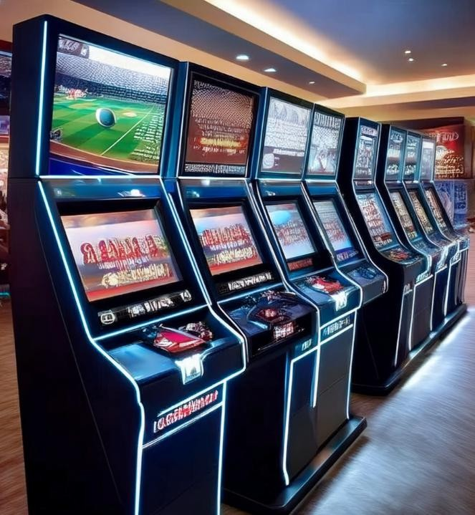



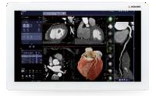

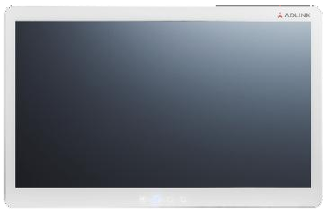







Edge Visualization BU
IDS
HBC
IBC
Industrial Display Solutions
Monitors
Panel PCs
Compact/ Mini Box PCs
Embedded GPU Products
Healthcare Solutions
Monitors
Panel PCs
Box PCs
Gaming Solutions
Box PCs
Monitors
Motherboards
I/O Controllers
Software (Advanced Gaming Architecture)

Slide 3








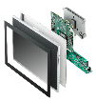




Industrial Display Solutions
2026 Q2
Released/MP
Under Development
Planning
Industrial Monitor
OM Series (Open Frame, 16:9, 5:4, 4:3)
IM-215/238AG
(*Anti-Glare)
Standalone Monitor 21.5”/23.8”
Titan2 Rugged Monitor
(*IP69K)
15.6”/21.5”/23.8”
OM-320/430
(*High Brightness)
2K FHD/4K UHD Resolution
IM Series (True Flat, 16:9, 5:4, 4:3)
All-in-One Panel PC
STC2-MTL
Intel Meteor Lake
10.1”/15.6”/21.5”
(*Optional – MXM Support)
STC2-TWL
Intel Twin Lake
10.1”/15.6”/21.5”
STC2 Series (TGL. KL, EHL, AL)
Open Frame Panel PC
SP2-TWL
Intel Twin Lake (N150, N250, N355)
10.1”/15.6”/21.5”
SP2 Series (MTL, EHL. TGL, AL, KL)
SP2 Next-Gen. ARM-based
SP2-IMX8 (NXP i.MX8 Plus)
Rugged Panel PC
Titan2-MTL
Intel® Core™ Ultra H series
15.6”/21.5”/23.8”
IP69K
Titan2 Series (TGL, 16:9)
Compact Box PC/ Media Player
EMP-520 (4x HDMI, EDID)
EMP-510 (1x DP, 3x HDMI)
EMP-100 (2x HDMI)
EMP-100-IMX8
(NXP i.MX8 Plus)
Mass Production & Shipping
2026 1H
2026 2H
Confidential

Slide 4




2026 Q2
MXM GPU Modules
Planning
Released/MP
Under Development
EGX-MXM-BW5000
NV Blackwell
GDDR7, 16GB, TGP 150W
Type B MXM
EGX-MXM-AD5000
NV Adalovelace AD103
GDDR6, TGP 80 – 150W
Type B MXM
EGX-MXM-BW4000
NV Blackwell
GDDR7, 16GB, TGP 115W
Type B MXM
Performance & Dimension
EGX-MXM-AD3500
NV Adalovelace AD104 GDDR6, TGP 60 – 115W
Type B MXM
EGX-MXM-BW2000
NV Blackwell
GDDR7, 8GB, TGP 60W
Type A MXM
EGX-MXM-AD2000
NV Adalovelace AD104 GDDR6, TGP 60 – 115W
Type A MXM
EGX-MXM-BW500
NV Blackwell
GDDR7, 6GB, TGP 35W
Type A MXM
Mass Production & Shipping
2026 1H
2026 2H

Slide 5




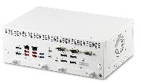



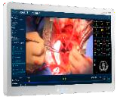


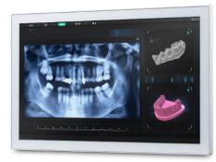



Healthcare Solutions
2026 Q2
Released/MP
Under Development
Planning
MLB-3000 Series
8th /9th Gen.
medical compliance
MLB-3100 Series
12th /13th Gen. medical compliance
MLB
Box PCs
MLB-3100 Series
14th /15th Gen. medical compliance w/ Blackwell MXM
MLC
Panel PCs
MLC-M Series
SP-TGL board, support 21”, 23”,
27”, 32” medical compliance
MLC-S
12th/13th Gen. medical compliance
MLC-M Series (Meteor Lake)
SP-MTL board, support 21”, 23”,
RFID, medical compliance
MLC-S
12th/13th Gen. MDR-Certified
ASM27/32/43UHB
IPS UHD with 700 cd/m² high brightness
ASM32mLED
mLED UHD with 1000cd/m² high brightness
ASM/ACM
Monitors
ACM
Cost-effective
Clinical monitor
21.5”/23.8”
ASM32U
IPS UHD with > 400 cd/m² high brightness
ASM
Cost-effective Edition
27”/32”
Mass Production & Shipping
2026 1H
2026 2H
Confidential

Slide 6




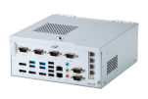




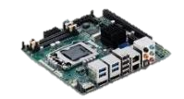




Gaming Solutions
2026 Q2
Released/MP
Under Development
Planning
System
SA3X-V2000
AMD V2000
GLI compliance
SA6X-ADL/RPL
Intel 12th / 13th Gen . GLI compliance
SA3X-PTL
Intel Core Ultra 300 GLI compliance
SA6X-RZ-E8K
AMD Ryzen E8000
GLI compliance
AmITX-AD-G
Intel 12th/13th/14th Gen. mini-ITX Gaming Board
AmITX-RZ-G
AMD Ryzen V1000/R2000
mini-ITX Gaming Board
AmITX-BTL-G
Mini-ITX Motherboard
Intel 15^{h} Gen Bartlett Lake
Mini-ITX Gaming Board
AmITX-RZ-G-E8K
AMD Ryzen E8000 Mini-ITX Gaming Board
I/O Controller
ADi-SIOG-FPGA
FPGA+PIC, I/O, NVRAM & SEC
ADi-SIOG-FPGA-G2
Lite & Modularized I/O, NVRAM & SEC
Mass Production & Shipping
2026 1H
2026 2H
Confidential

Slide 7
Gaming Monitors
2026 Q2
Released/MP
Under Development
Planning
GM-490
49”J/C (UHD/500nits)
GM-240DS (Next-Gen.)
24” Dual Sided Portrait Display w/LED (FHD/600nits)
GM-270
27” (FHD/240nits)
GM-550
55”J/C (UHD/500nits)
GM-270S
27” (FHD/400nits)
GM-240D
24” Dual Sided Portrait Display (FHD/600nits)
GM-320/430
32” (FHD/IPS)
43” (UHD/IPS)
GM-320
32” (FHD/400nits)
GM-070
7” (FHD/300nits)
GM-320S
32” (FHD/400nits)
GM-270
27” (UHD/400nits)
Player Button Deck
15.6” LCD/TP
Mass Production & Shipping
2026 1H
2026 2H
Confidential

Slide 8
Thank You.
ADLINK Technology, Inc.
No. 66, Huaya 1st Rd., Guishan Dist., Taoyuan City 333411, Taiwan
Tel: +886-3-216-5088
Fax: +886-3-328-5706

